Slide 1
Welcome! 2016-17 Arlington Middle School Orchestra Parent Meeting
Cody Price
acsorchestra.weebly.com

Slide 2
Join my Remind101 for updates and reminders
through Text
Number:
81010
Body of text: @6AMSprice @7AMSprice @8AMSprice @helpprice
@stringssym

Slide 3
You will need:
A Pencil is required at EVERY rehearsal!
Keep one inside your instrument case or folder so you are never without it! This is part of your student’s daily grade.
Instrument, bow, and case with secure latch and/or zippers.
Shoulder Rest (violin and viola only)
Rock-stop (cello and bass only)
Rosin
Cleaning cloth
Extra set of strings (optional)
Music Stand

Slide 4
There is ALWAYS homework in Orchestra!
How much should I practice at home?
All Grades: required 80 minutes/week. (16 minutes a day, 5 days a week)
I will not penalize for a parent’s busy night! Contact me via Remind101 or email if you ever forget to sign your student’s practice chart
Due last day of each week (-5 minutes per day late)

Slide 5
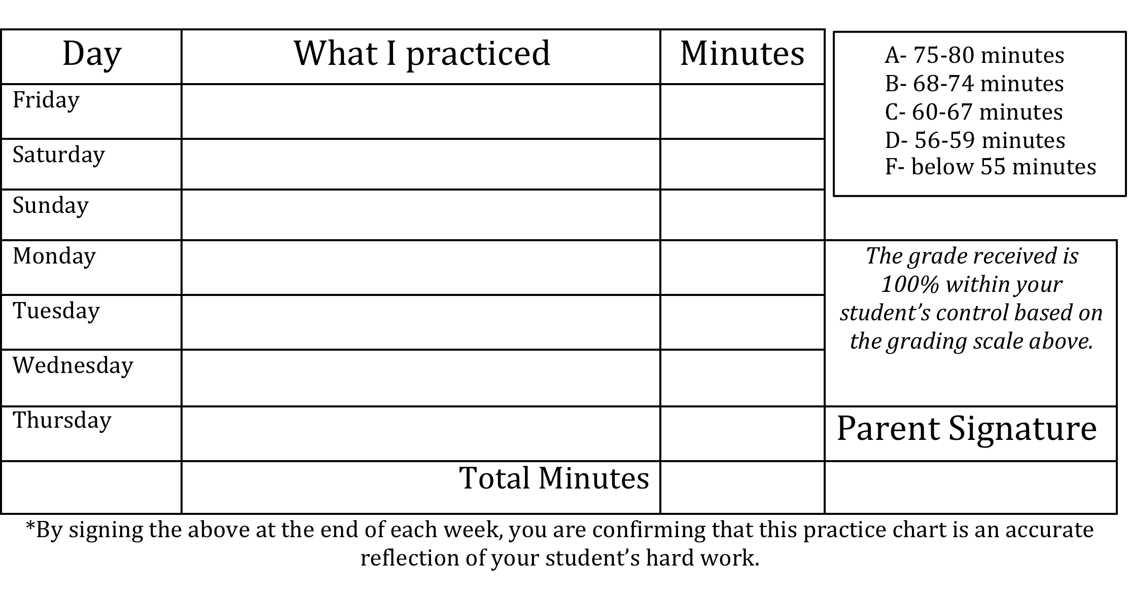

Slide 6
Instrument Care
Your instrument is your baby, not a toy!
Store away from vents and windows to ensure a constant temperature and humidity.
Always open case on a stable surface. The floor or a clean, clear table are the best options.
Wipe the strings with a soft, dry cloth after playing. Stay away from cleaners (especially scented/oil based)

Slide 7
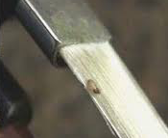
Don’t touch the bow hair!

Slide 8
Cello and Bass
Bow should be unpacked first, and put away last.

Slide 9
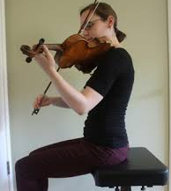
Posture Requirements
Students will be expected to sit on the very edge of their seat, feet flat on the floor while playing.
The health of all students will always come first. If you have medical concerns that might interfere with posture requirements in class, please let me know!

Slide 10
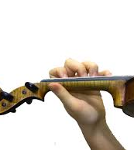
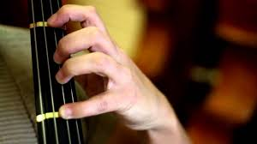
Fingernails
Fingernails must be kept “thumpy” not “clicky”

Slide 11
All performance dates and times are subject to change. At least 4 weeks notice will be given for every performance via the orchestra website and a letter home. All performances are required unless otherwise indicated.
AMS Orchestra Performance Opportunities | Information
Veterans Day Assembly | November TBA, 8th grade only, in-school performance
Holiday Concert | December 19th, 6:30pm AHS Auditorium, all grades
All-West Auditions | November 18st, times TBA Optional for all
Pre-Festival Spotlight | February 27th, 7pm AHS Auditorium
Concert Festival | Cordova High School March 6th-8th, 7th and 8th grade only
Performance Trip | TBA
Spring Concert | May 8th, 7pm AHS Auditorium All grades

Slide 12
Your student’s presence is necessary and expected!
There is no way to make up the experience of a public performance.
No amount of homework can amount to the same educational value as performing with peers in front of an audience.
However, to make up the points in the grade book, an alternate assignment may be issued at the discretion of the director.

Slide 13
Concert Dress
Ladies:
-Black shoes w/ appropriate heal height, black bottoms, white dress shirt/blouse. If wearing a skirt, legs must be covered with black nylons/hosiery/leggings. Tastefully jewelry is permitted as long as it does not interfere with the sound of the instrument.
Gentlemen:
- Black dress shoes, black socks, Black dress pants, white button down shirt, black tie (bow or straight).
All concert attire must meet the ACS dress code outlined in the student handbook. Students inappropriately dressed will receive a failing grade for that performance and will be sent home to complete an alternate assignment.

Slide 14
Performing Arts Travel Expectations Contract

Slide 15
Renting Vs Buying
When to RENT
When to BUY
Are you a 1st year string player?
Are you growing fast?
Are you interested in switching instruments now or in the future?
Do you love the instrument you play?
Do you plan to play through High School?
Are you currently playing a full sized instrument?

Slide 16
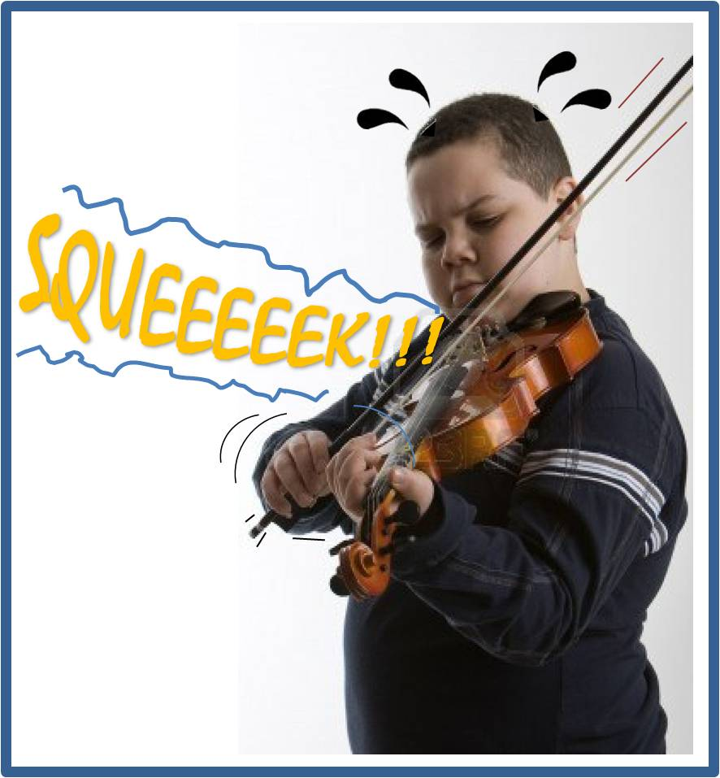
NEVER purchase an instrument without holding it in your hands first!

Slide 17
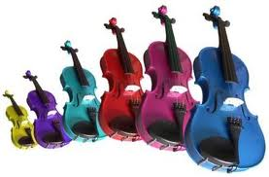
Colored instruments are cool BUT…
Stay far, far away!! They will not be permitted in class or at performances.

Slide 18
Where to go for instruments, repairs, and supplies?
Amro
2918 Poplar Ave, Memphis
Lane Music
9309 Poplar Ave, Memphis
Bartlett Music Academy
7505 U.S. 64, #107 Memphis
Shar Music
Sharmusic.com

Slide 19
Join my Remind101 for updates and reminders
through Text
Number:
81010
Body of text: @6AMSprice @7AMSprice @8AMSprice @helpprice

